Slide 1
Understanding Legal Texts
Rhetorical roles prediction
Court Judgement Prediction
Team Indexers and Searchers
Aashwin Vaish (2019114014)
Akshett Rai Jindal (2019114001)
Chayan Kochar (2019114008)
Suyash Vardhan Mathur (2019114006)

Slide 2
Motivation
The number of legal cases has been growing almost exponentially in populous countries like India.
For example, as per the India’s National Judicial Data Grid, there are about 41 million cases pending in India (National Judicial Data Grid, 2021).
As per some of recent estimates by a retired Supreme Court of India Judge, it will take about 450 years to clear the backlog of cases (Katju, 2019).

Slide 3
Use of Automated Analysis
As new-age technologies such as AI, ML, and NLP have penetrated almost all industries, the use of them in law and order can prove to be of immense help in improving our judicial system
Recently, law minister Kiren Rijiju and CJI S A Bobde said that AI can help in reducing the backlog of pending cases and sustainable justice delivery.
With the creation of large annotated corpora and introduction of deep learning models, various tasks like summarization, segmentation, annotation, and even judgement prediction tasks have been performed on Legal Text.

Slide 4
Introduction
A legal document processing system would benefit substantially if the documents could be segmented into coherent information units.
Using such a technique, important segments can be factored and it can help with tasks where SOTA models have limits on number of tokens - like Summarization, Keyword Extraction, Court Judgement Prediction.
For automatically segmenting the legal documents, we experiment with the task of rhetorical role prediction: given a document, predict the text segments corresponding to various roles.
Thus, through segmentation of an unstructured legal document, we can improve on the task of Court Judgement Prediction.

Slide 5
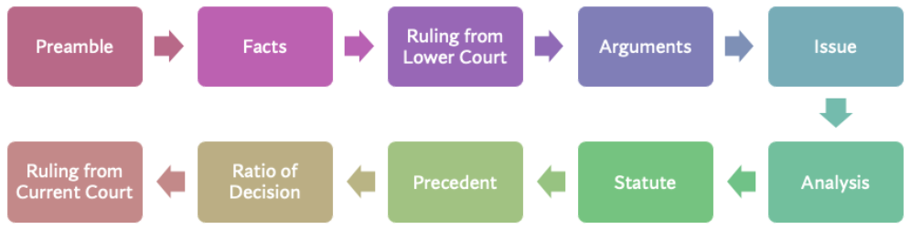
Rhetorical Roles Prediction
Rhetorical Roles help structuring legal documents by segmenting them into topically coherent units.
Such roles include the Arguments given, the Issues described, the different Rulings from courts, etc.
Thus, most documents would consist of such roles roughly following an inherent structure of these units, such that it would start with a Preamble, State the facts related to the case, Analysis from the petitioners, etc.
A typical flow of the structure for Indian Legal Documents is shown below. The flow is not necessarily linear, and can appear in any order.
Credits: tps://github.com/Legal-NLP-EkStep/rhetorical-role-baseline

Slide 6
Example Roles
Fact (FAC): These are the facts specific to the case based on which the arguments have been made and judgment has been issued.
ARG_PETITIONER: Arguments by petitioners' lawyers.
Ratio of Decision(ROD): Main Reason given for the application of any legal principle to the legal issue. This is the result of the analysis by the court. This typically appears right before the final decision.
Ruling By Present Court (RPC): Final decision + conclusion + order of the Court following from the natural / logical outcome of the rationale

Slide 7
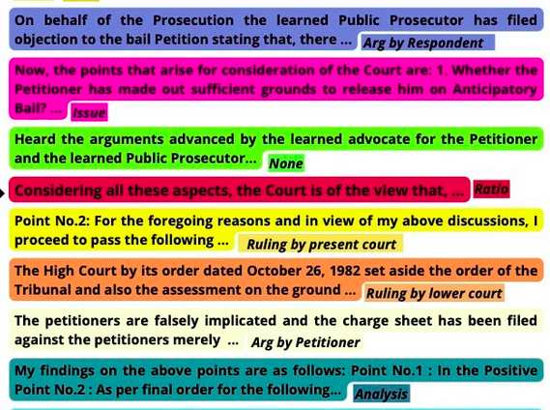
Example Roles

Slide 8
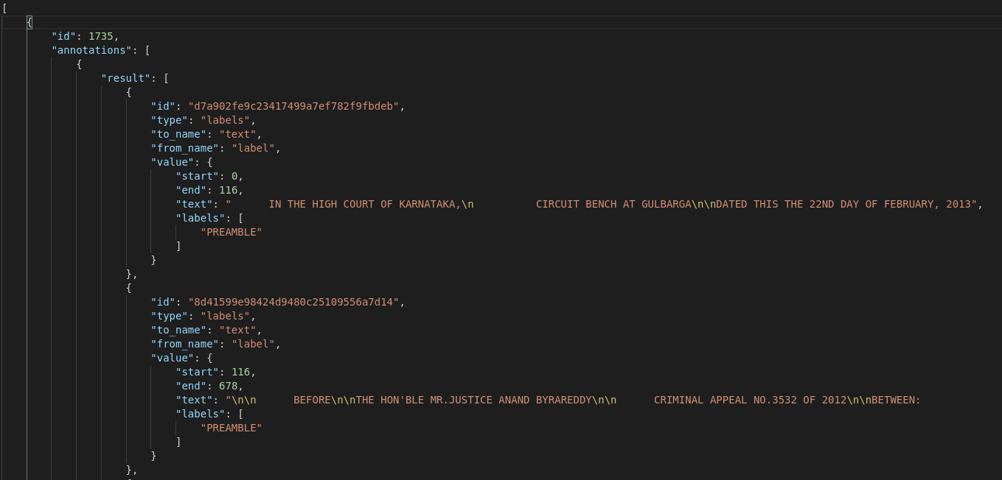
Dataset Used
We use the data presented in the LegalEval 2023 task for Rhetorical Role Prediction.
The data annotations were done by Law students from multiple Indian law universities where each sentence was classified into one of the 13 pre-defined rhetorical roles.

Slide 9
Task and Methodology
Task Definition: Given a legal document, D, containing the sentences [s₁, s₂, ...s_{n}], the task of rhetorical role prediction is to predict the label (or role) y_{i} for each sentence s_{i} ∈ D.
For the first set of models, the task is modeled as a single sentence prediction task, where given the sentence s, the model predicts the rhetorical role of the sentence.
BERT
LegalBERT
SBERT
For another set of models, we consider this task as a sequence labelling task, where the sequence of all the sentences in the document is given as input, and the model has to predict the RR label for each sentence.
BiLSTM
BiLSTM with CRF layer

Slide 10
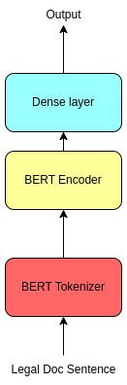
Baseline Model
Our Baseline model makes use of BERT embeddings, which are pooled in various ways(max-pooling, mean-pooling, CLS-pooling) to get sentence-level embeddings.
These sentence level embeddings are then fed to a fully-connected layer, which predicts the scores for each of the 13 classes.
We also experimented with LegalBERT embeddings, as well as S-BERT embedings for representing the sentences in the Legal Text.
This treats labelling each sentence independently, and doesn't consider the neighbouring context for each sentence.

Slide 11
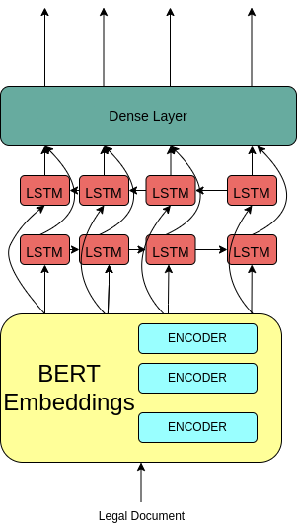
Baseline+ Bi-LSTM Model
This model treats the problem of Rhetorical Role Labelling as a sequence labelling problem rather than a sentence-label problem.
The sentence level embeddings generated previously are all now fed to a Bi-LSTM layer, which aggregates context from the neighbouring sentence.
The final hidden layer output from the Bi-Directional LSTMs is fed to a Dense layer, which provides a score for all the different classes.
We also tried using multiple stacks of LSTMs, but the changes in accuracy were insignificant.

Slide 12
Baseline++ Bi-LSTM CRF Model
This model adds a CRF Layer on top of the Bi-LSTM layer.
This model was used because the problem here is that of a sequence tagging problem, in which CRFs are known to improve baseline results.
In case of the previous model, each classification decision was conditionally independent.
Linear-chain CRF instead explicitly models dependencies between the labels as a table with transition scores between all pairs of the labels.
Thus, BiLSTM knows about the language, while CRF knows the internal logic of the labeling, improving the results.
CRF

Slide 13
Results
The weighted F1 Scores for all the models are below:
Model | Precision | Recall | F1-Score
BERT | 0.59 | 0.57 | 0.55
Legal-BERT | 0.56 | 0.56 | 0.54
S-BERT | 0.50 | 0.52 | 0.51
Bi-LSTM | 0.63 | 0.65 | 0.62
Bi-LSTM CRF | 0.76 | 0.76 | 0.74

Slide 14
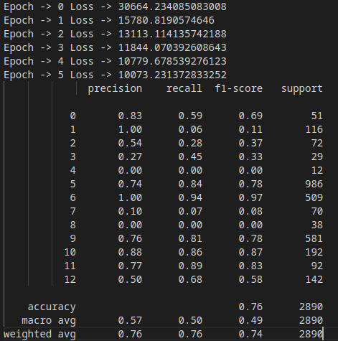
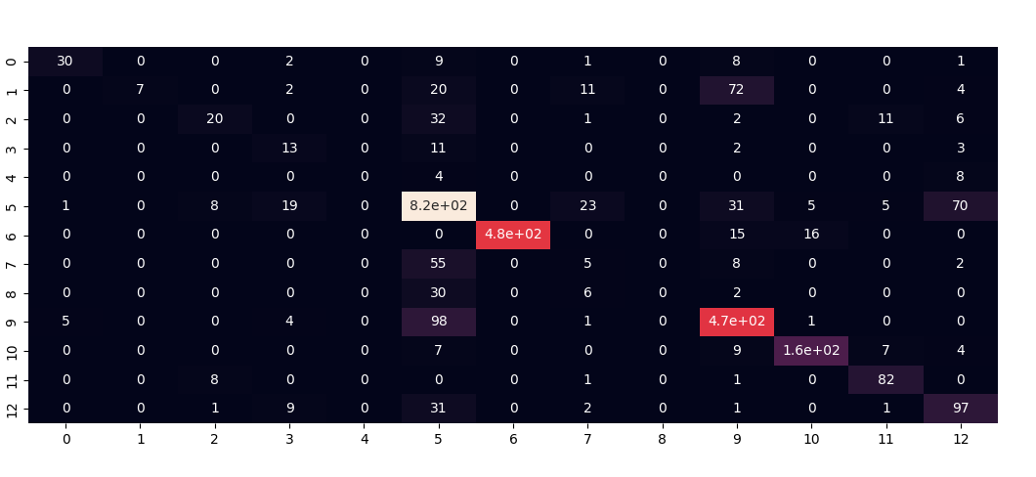
Results

Slide 15
Observations
We observed a dip in accuracy in LegalBERT as compared to normal BERT. This is possible because LegalBERT is trained on American Legal Corpus, which has a different structure from Indian Legal Text.
LSTMs greatly improved the accuracy of the model. This is because it took the neighbouring context into account, and modelled the structure of the document.
Addition of further stacks of LSTMs didn’t improve the results. This was probably because the context needed to predict the labels is that of last few sentences. Long-term dependencies are negligible here.
CRFs provide further improvements as they model the label-sequence better.

Slide 16
Court Judgement Prediction
Given a legal judgment document, the task involves automatically predicting the outcome (binary: accepted or denied) of the case.
A system capable of assisting a judge by suggesting the outcome of an ongoing court case is likely to be useful for expediting the judicial process. But an automated decision system is not tenable in law unless the outcome is well reasoned in terms of how humans understand the legal process. Hence, it is necessary to explain why a suggestion was made
But in this project, we would be focusing only on the judgement, and explanation will be taken up as a future task

Slide 17
Task and Methodology
Task Definition: Given a case proceeding D(document), the task is to predict the decision y ∈ {0, 1}, where the label 1 corresponds to the acceptance of the appeal/petition of the appellant/petitioner.
For the first set of models, we are experimenting with BERT and its variants and directly classifying it.
Due to limitation on the number of input tokens to BERT and other transformer models, we experimented with different sections (begin tokens, middle tokens, end tokens, combinations of these) of the documents.
For another set of models, we are looking into hierarchical transformer models.
Dividing each doc into chunks of 512 tokens.
Obtaining the CLS representation of these chunks.
Feed them to BiGRU + attention model

Slide 18
Aid of Rhetorical Roles
Judgement Prediction for entire documents is difficult since documents are typically longer, and SOTA transformer architectures have a limit on the number of tokens they can handle.
Rhetorical Role labelling can help in identifying the relevant sentences for Judgement Prediction task, reducing the number of tokens involved.
Further, even certain Rhetorical Roles might have more importance than others while predicting judgement, and thus, these can be used as features for the CJP task too!

Slide 19
References
Semantic Segmentation of Legal Documents via Rhetorical Roles (Vijit et al.)
Corpus for Automatic Structuring of Legal Documents (Kalamkar et al.)
ILDC for CJPE: Indian Legal Documents Corpus for Court Judgment Prediction and Explanation (Vijit et al.)
https://towardsdatascience.com/implementing-a-linear-chain-conditional-random-field-crf-in-pytorch-16b0b9c4b4ea

